Slide 1

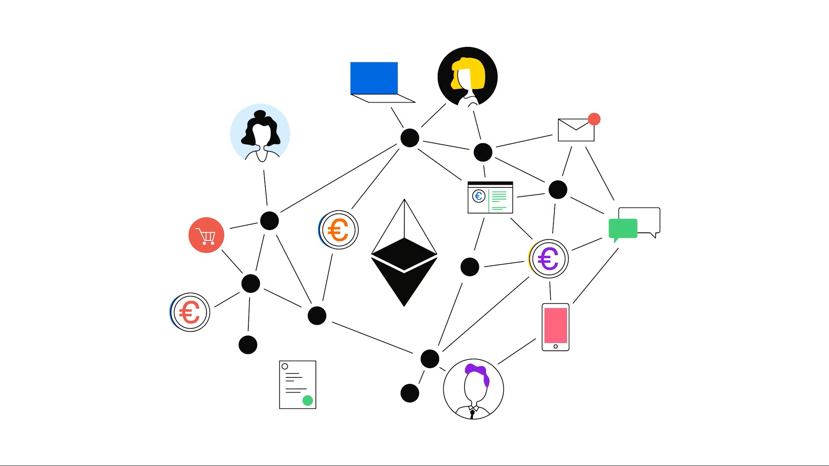
Blockchain-Based Wine Supply Chain Traceability System: A Decentralized Approach to Supply Chain Transparency
Ensuring Transparency, Security, and Efficiency in Wine Distribution
Presented by:
Karthikeyan Karuppaiah
MSc Advanced Computer Science– Newcastle University
Supervisor: Yinhao Li

Slide 2

Introduction & Context
Why Wine Supply Chain Traceability?
Wine authenticity & provenance are critical for quality assurance.
Traditional tracking systems are prone to fraud, errors, and lack transparency.
Blockchain provides an immutable, decentralized record of transactions.
Smart contracts automate workflows and role-based access control.
Consumers can verify product history without intermediaries.

Slide 3
Challenges in the Current Wine Supply Chain
Industry Problem
Counterfeit wine costs billions annually, damaging brand trust.
Lack of real-time traceability in traditional supply chains.
Reliance on centralised systems → single point of failure, limited transparency.
Why Blockchain?
Immutable ledger ensures data integrity.
Decentralised verification removes need for trusted intermediaries.
Smart contracts enable automated rule enforcement

Slide 4

What This Project Aims to Achieve
Develop a blockchain-based traceability system for wine batches.
Implement role-based access control (RBAC) for Producers, Distributors, Retailers, and Admin.
Allow public verification of wine batches via QR code or link.
Optimize smart contracts for gas efficiency and storage cost reduction.
Deploy on Ethereum Sepolia testnet with professional hosting.

Slide 5

Research Gap
Many blockchain supply chain solutions are only proof-of-concept.
Complex UI and wallet requirements hinder non-technical adoption.
Few systems integrate public verifiable tracking without requiring a blockchain wallet.
High gas costs in naive implementations discourage real-world deployment.

Slide 6
Proposed Architecture Overview
IoT Layer – (Optional for integration) Data capture at source.
Frontend Layer – React + Vite UI for all stakeholders.
Smart Contract Layer – Solidity + Ethereum Sepolia Testnet.
Verification Layer – Public URL verification via Etherscan / app without MetaMask.

Slide 7
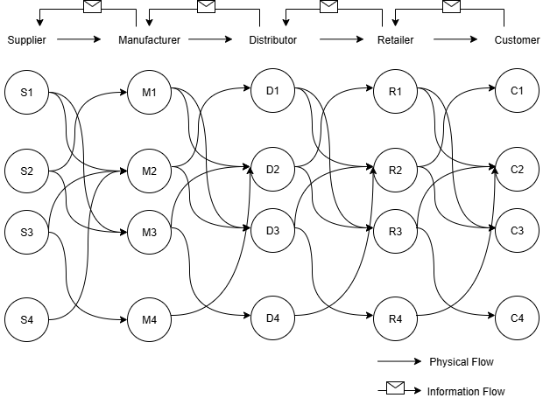

Slide 8
